Slide 1
Camidanlumab tesirine efficacy and safety in an open-label, multicenter, Phase 2 study of patients with relapsed or refractory classical Hodgkin lymphoma (R/R cHL)
Pier Luigi Zinzani¹, Carmelo Carlo-Stella², Mehdi Hamadani³, Alex F. Herrera⁴, Stephen M. Ansell⁵, John Radford⁶, Kami Maddocks⁷, Justin Kline⁸, Kerry J. Savage⁹, Nancy L. Bartlett¹⁰, Paolo F. Caimi¹¹, Yanina Negievich¹², Hans G. Cruz¹², Luqiang Wang¹³, Jens Wuerthner¹², Graham P. Collins¹⁴
¹IRCCS Azienda Ospedaliero-Universitaria di Bologna Istituto di Ematologia "Seràgnoli", and Dipartimento di Medicina Specialistica, Diagnostica e Sperimentale Università di Bologna, Bologna, Italy; ²Department of Oncology and Hematology, Humanitas Clinical and Research Center – IRCCS, and Humanitas University, Milano, Italy; ³BMT & Cellular Therapy Program, Department of Medicine, Medical College of Wisconsin, Milwaukee, WI, USA; ⁴Department of Hematology & Hematopoietic Cell Transplantation, City of Hope Comprehensive Cancer Center, Duarte, CA, USA; ⁵Division of Hematology, Mayo Clinic, Rochester, MN, USA; ⁶NIHR Manchester Clinical Research Facility, The Christie NHS Foundation Trust and University of Manchester, Manchester Academic Health Science Centre, Manchester, UK; ⁷Division of Hematology, Ohio State University Medical Center, Columbus, OH, USA; ⁸Department of Medicine, The University of Chicago, Chicago, IL, USA; ⁹Department of Medical Oncology, BC Cancer and University of British Columbia, Vancouver, BC, Canada; ¹⁰Division of Oncology, Washington University School of Medicine in St Louis, St Louis, MO, USA; ¹¹University Hospitals Cleveland Medical Center/Case Western Reserve University, Cleveland, OH, USA; ¹²Clinical Development, ADC Therapeutics SA, Epalinges, Switzerland; ¹³ADC Therapeutics America Inc., Murray Hill, NJ, USA; ¹⁴NIHR Oxford Biomedical Research Centre, Oxford Cancer and Haematology Centre, Churchill Hospital, Oxford, UK
16th International Conference on Malignant Lymphoma (ICML)
Virtual Congress, June 18–22, 2021

Slide 2
Author Disclosures, Acknowledgments and Funding
PL Zinzani: Consultant for EUSA Pharma, Merck Sharp & Dohme (MSD), Sanofi, Verastem; advisory committee for ADC Therapeutics, Sandoz; speaker bureau or advisory committee for, Bristol-Myers Squibb (BMS), Celltrion, EUSA Pharma, Gilead, Janssen-Cilag, Kyowa Kirin, MSD, Roche, Servier, Takeda, TG Therapeutics, Verastem C Carlo-Stella: Consultant/advisor for ADC Therapeutics, BMS, Celgene/BMS, Incyte, Karyopharm, Roche, Sanofi; speaker honoraria from AstraZeneca, Celgene, Gilead Sciences, Incyte, Janssen Oncology, MSD, Takeda; research support from ADC Therapeutics M Hamadani: Consultant for AbGenomics, ADC Therapeutics, Celgene Corporation, Incyte Corporation, Janssen R&D, Omeros, Pharmacyclics, TeneoBio, Verastem; speaker bureau for AstraZeneca, BeiGene, Sanofi Genzyme; research support from Astellas Pharma, Spectrum Pharmaceuticals, Takeda AF Herrera: Consultant/advisor for BMS, Genentech/Roche, Karyopharm, Merck, Seattle Genetics; research funding to institution from BMS, Genentech/Roche, Immune Design, Merck, Pharmacyclics, Seattle Genetics; travel/accommodation/expenses from BMS SM Ansell: Research funding from ADC Therapeutics, Affimed, AI Therapeutics, BMS, Regeneron, Seattle Genetics, Trillium J Radford: Consultant/advisor for ADC Therapeutics, BMS, Kite Pharma, Novartis, Takeda; speaker for ADC Therapeutics, Seattle Genetics, Takeda; stock ownership with ADC Therapeutics and AstraZeneca (spouse); honoraria for expert testimony from ADC Therapeutics and Takeda; research funding from Takeda K Maddocks: Consultant/advisor for ADC Therapeutics, AstraZeneca, BMS, Celgene, Gilead, Karyopharm, MorphoSys, Pharmacyclics, Seattle Genetics; research funding from BMS J Kline: Consultant/advisor for Karyopharm, Kite/Gilead, Merck, MorphoSys, Seagen, Verastem; research funding from iTeos, Merck, Verastem
KJ Savage: Consultant/advisor for AstraZeneca, BMS, Gilead, Janssen, Kyowa, Merck, Novartis, Seattle Genetics, Servier; honoraria from AstraZeneca, BMS, Gilead, Janssen, Kyowa, Merck, Novartis, Seattle Genetics; research funding to institution from Roche; renumeration from BeiGene (Steering Committee) NL Bartlett: Consultant/advisor for ADC Therapeutics, Autolus, BMS, Celgene, Forty-Seven, Immune Design, Janssen, Kite Pharma, Merck, Millennium, Pfizer, Pharmacyclics, Roche/Genentech, Seattle Genetics; research funding from ADC Therapeutics PF Caimi: Advisory board for ADC Therapeutics, Amgen, Genentech, Kite Pharmaceuticals, Seattle Genetics, Verastem; consultancy for TG Therapeutics; speaker bureau for Celgene; research support from ADC Therapeutics and Genentech GP Collins: Consultant/advisor for ADC Therapeutics, BeiGene, BMS, Celgene, Celleron, Daiichi Sankyo, Gilead, Incyte, MSD, Novartis, Roche, Takeda; research funding from Amgen, BMS, Celgene, Celleron, MSD
HG Cruz, Y Negievich, L Wang, and J Wuerthner: Employees of ADC Therapeutics with stock ownership
Acknowledgments & study funding
The authors thank all participating patients and their families, and all study co-investigators and research coordinators Editorial support was provided by Heather St Michael of Fishawack Communications Ltd, part of Fishawack Health, funded by ADC Therapeutics This study is funded by ADC Therapeutics SA (NCT04052997)

Slide 3
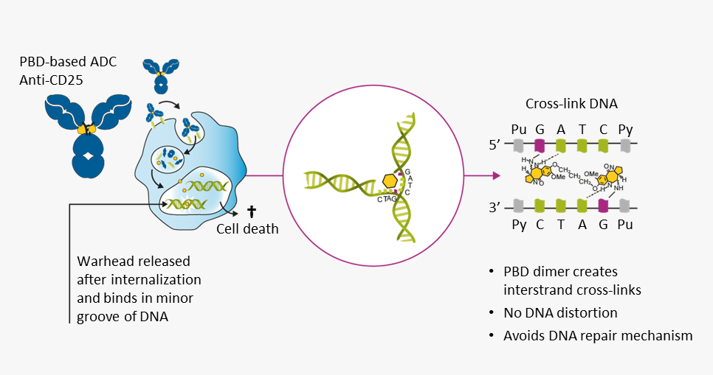
Introduction
Limited therapeutic options are available for patients with R/R cHL who are unresponsive to, or whose disease progresses after, BV and PD-1 blockade therapy.^{1–5} Novel treatments are required to address this unmet need
Camidanlumab tesirine (Cami) is an Ab-drug conjugate comprising a human IgG1 anti-CD25 monoclonal Ab conjugated to a potent PBD dimer warhead⁶
Treatment with Cami demonstrated encouraging antitumor activity and manageable toxicity:
In a Phase 1 trial that included patients with R/R cHL who received Cami at a dose of 45 µg/kg and achieved an overall response rate (ORR; CR + PR) of 86.5%⁷
In the initial findings of this Phase 2 study of patients with R/R cHL, who achieved an ORR of 83.0%⁸
Here, we present preliminary results from this Phase 2 study of patients with R/R cHL (NCT04052997) after meeting target enrollment (100 patients)
1. Mehta-Shah N, et al. Blood 2018;131:1698–1703; 2. Mottok A, et al. Blood 2018;131:1654–1665; 3. Glimelius I, et al. J Intern Med 2017;281:247–260; 4. Eichenauer DA, et al. Ann Oncol 2018;29:iv19–29; 5. Shanbhag S, et al. CA Cancer J Clin 2018;68:116–132; 6. Flynn MJ, et al. Mol Cancer Ther 2016;15;2709–2721; 7. Hamadani M, et al. Lancet Haematol 2021;8(6):e433-e445 [doi:10.1016/S2352-3026(21)00103-4, Epub May 25, 2021]; 8. Herrera A, et al. Oral presentation, ASH Virtual Meeting, Dec 5–8, 2020 [data cut-off Aug 24, 2020; initial findings reported with target recruitment almost 50% complete]. Ab, antibody; BV, brentuximab vedotin; cHL, classical Hodgkin lymphoma; Ig, immunoglobulin; PBD, pyrrolobenzodiazepine; PD-1, programmed cell death protein 1; R/R, relapsed or refractory.

Slide 4
Study Design
Ongoing, Phase 2, single-arm, multicenter, open-label study in patients with R/R cHLª
30-minute IV infusion of Cami on Day 1 of each 3-week cycle
45 µg/kg
30 µg/kg
Cycles 1 & 2
Cycle 3 onwards, up to 1 year^{b}
ª Safety analysis set comprises all patients who received ≥1 dose of Cami; efficacy analysis set comprises patients who started treatment ≥12 weeks before data cut-off (Mar 26, 2021) or with ≥2 post-baseline disease assessments, or who died before the second disease assessment; ^{b} Or until discontinuation due to disease progression, unacceptable toxicity, or other reasons. Patients deriving clinical benefit at 1 year may be able to continue treatment on a case-by-case basis.
cHL, classical Hodgkin lymphoma; IV, intravenous; R/R, relapsed or refractory.

Slide 5
Key Study Endpoints
Primary endpoint
Efficacy of single-agent Cami by ORR (per 2014 Lugano classification; complete + partial response) assessed by central review
Secondary endpoint
Duration of responseª, progression-free survival^{b}, and proportion of patients who receive hematopoietic stem cell transplantation
Safety per frequency and severity of adverse events
ª Defined as time from first documentation of tumor response to disease progression or death; ^{b} Defined as time from first dose of study drug until first date of either disease progression or death due to any cause. ORR, overall response rate.

Slide 6
Key Inclusion and Exclusion Criteria
Inclusion Criteria
Exclusion Criteria
Male or female
≥18 years (≥16 years in US)
Pathologic diagnosis of cHL
Patients with R/R cHL who received ≥3 prior systemic therapy lines (or ≥2 lines if ineligible for HSCT)
Prior treatment with BV and PD-1 blockade therapy
Measurable disease (2014 Lugano classification)
Eastern Cooperative Oncology Group performance status score of 0–2
Adequate organ function
Previous Cami treatment
Hypersensitive to or positive serum for ADA to CD25 antibody
Allogeneic/autologous HSCT ≤60 days before start of Cami treatment
History of neuropathy considered of autoimmune origin (e.g., polyradiculopathy including GBS and myasthenia gravis) or other CNS autoimmune disease, such as poliomyelitis or MS
Recent infection (<4 weeks of Cycle 1, Day 1) considered caused by pre-specified pathogens
HIV, HBV, or HCV infection needing antiviral therapy/prophylaxis
Clinically significant third-space fluid accumulation (i.e., ascites requiring drainage, or pleural effusion requiring drainage or associated with shortness of breath)
ADA, anti-drug antibody; BV, brentuximab vedotin; cHL, classical Hodgkin lymphoma; GBS, Guillain-Barré syndrome; HBV, hepatitis B virus; HCV, hepatitis C virus; HIV, human immunodeficiency virus; HSCT, hematopoietic stem cell transplantation; MS, multiple sclerosis; PD-1, programmed cell death protein 1; R/R, relapsed or refractory.

Slide 7
Baseline Characteristics
Characteristic |  | Total (N=117)
Sex, n (%) | Male | 73 (62.4)
 | Female | 44 (37.6)
Age, years, median (min, max) |  | 37 (19, 87)
Histology, n (%) | Nodular sclerosis cHL | 91 (77.8)
 | Other/unknown/not evaluableª | 26 (22.2)
ECOG status, n (%) | 0 | 63 (53.8)
 | 1 | 48 (41.0)
 | 2 | 6 (5.1)
No. prior systemic therapies^{b}, median (range) |  | 6 (3–19)
Prior BV and PD-1 blockade, n (%) | BV | 116 (99.1)
 | PD-1 blockade therapy | 117 (100)
 | BV and PD-1 blockade therapy | 116 (99.1)^{c}
Prior HSCT, n (%) | Autologous | 58 (49.6)
 | Allogeneic | 3 (2.6)
 | Both | 12 (10.3)
No. of cycles, mean (SD) |  | 4.6 (2.5)
Disease status after first-line systemic therapy, n (%) | Relapsed | 77 (65.8)
 | Refractory | 29 (24.8)
 | Other^{d} | 11 (9.4)
Disease status after last-line systemic therapy, n (%) | Relapsed | 38 (32.5)
 | Refractory | 66 (56.4)
 | Other^{d} | 13 (11.1)
At data cut-off (Mar 26, 2021):
No. of patients enrolled 117
Mean (SD) No. of cycles 4.6 (2.5)
Heavily pre-treated patients; median (range) prior lines of systemic therapy 6 (3–19)
No. of patients with prior brentuximab vedotin and PD-1 blockade therapy 116 (99.1%)^{c}
ª Includes mixed cellularity and lymphocyte-rich cHL (n=11), cHL subtype not specified (n=1) or unknown (n=12), cHL Epstein-Barr virus-associated (n=1), and missing (n=1); ^{b} Includes prior HSCT; ^{c} One patient did not receive BV owing to a protocol deviation; ^{d} Missing or not evaluable. BV, brentuximab vedotin; cHL, classical Hodgkin lymphoma; ECOG, Eastern Cooperative Oncology Group; HSCT, hematopoietic stem cell transplantation; PD-1, programmed cell death protein 1; SD, standard deviation.

Slide 8
Overall Response Rateª
ORR (CR + PR)
66.3% (67/101)
95% CI: 56.2, 75.4
No. of patients with CR
28 (27.7%)
No. of patients with PR
39 (38.6%)
No. of patients reporting HSCT as reason for discontinuation 9 (7.7%)^{b}
ª Per central review. Efficacy analysis set (n=101) defined as patients with ≥12 weeks of follow-up since first dose or ≥2 post-baseline disease assessments, or who died prior to their second disease assessment. Five (5.0%) patients died prior to second disease assessment: 2 of whom did not have a scan/new anticancer therapy; 1 who had no scan following new anticancer therapy, 1 who had no second scan/new anticancer therapy, and 1 who had no second scan following new anticancer therapy; ^{b} Of these 9 patients, 1 died due to disease progression (1 year post haploidentical transplant) and 8 were alive and being followed-up at the time of data cut-off. CI, confidence interval; HSCT, hematopoietic stem cell transplantation; ORR, overall response rate.

Slide 9
Results in Context with Prior Analyses
Phase 1 Cami Study¹
Phase 2 Cami Study Prior data cut³
Phase 2 Cami Study Current data cut
ORR: 86.5% (32/37)
ORR: 83.0% (39/47)
ORR: 66.3% (67/101)
100
4.3
90
10.6
2.1
80
70
60
44.7
Response (%)
50
40
30
20
38.3
10
0
Patients (n=47)
Median (range) study duration 10.3 (0.6, 25.9+) months²
Median (range) study duration 6.1 (2.0, 10.9+) months²
Median (range) study duration 5.1 (1.2, 18.0+) monthsª
Key
CR
PR
SD
PD
NE
ª Versus the Phase 1 study and prior data cut of this Phase 2 study, median study duration is shorter. Potential reasons include patient enrollment in this data cut having an unusual distribution; likely due to a prior enrollment pause that, when lifted, meant many patients enrolled, impacting median duration (calculated using each patient’s individual study duration). 1. Hamadani M, et al. Lancet Haematol 2021;8(6):e433-e445 [doi:10.1016/S2352-3026(21)00103-4, Epub May 25, 2021]; for data shown, patients with R/R cHL received Cami 45 µg/kg Q3W; 2. Data on file, ADCT Therapeutics 2021; 3. Originally presented at the 62nd ASH Annual Meeting and Exposition Virtual Meeting, Dec 5–8, 2020, by Herrera A, et al. Preliminary Results of a Phase 2 Study of Camidanlumab Tesirine (Cami), a Novel Pyrrolobenzodiazepine-Based Antibody-Drug Conjugate, in Patients With Relapsed or Refractory Hodgkin Lymphoma. © American Society of Hematology. Patients received 45 µg/kg Q3W for first 2 cycles, then 30 µg/kg for subsequent cycles; data cut-off Aug 24, 2020. + denotes censored (study duration was calculated from first dose date to end of study visit for completed patients or to data cut-off date for ongoing patients); CR, complete response; NE, not evaluable; ORR, overall response rate; PD, progressive disease; PR, partial response; Q3W, every 3 weeks; SD, stable disease.

Slide 10
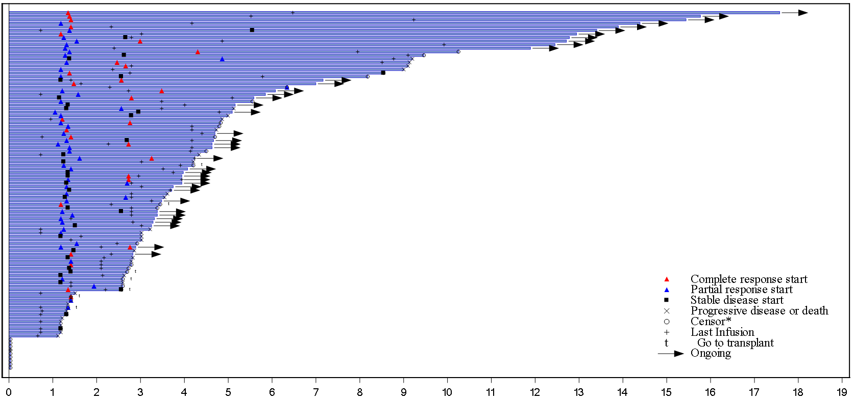
A Significant Number of Patients Experience Long-lasting Treatment Effects
Patients
Complete response start
Partial response start
Stable disease start
Progressive disease or death
Censor*
Last infusion
Go to transplant
Ongoing
Time (months) since first dose
Each bar represents one patient in the study. Response is determined by independent reviewer. Efficacy analysis set includes patients who started treatment at least 12 weeks before data cut-off date or with at least two post-baseline disease assessment results from independent reviewer or death prior to the second scheduled disease assessment according to protocol schedule. * Only for censored patients who discontinued the study due to reasons other than progression, or who went on to a different anticancer treatment other than transplant, or who are ongoing but have no disease assessment yet.

Slide 11
Duration of Response
Censored
Response
Median (95% Cl) months
CR
PR
CR+PR
Not reached
7.85 (2.60, )
Not reached
1.0
0.9
0.8
0.7
0.6
0.5
Probability
0.4
Median DOR not reached
0.3
0.2
Median (range) follow-up 5.1 (1.2–18.0+) months
0.1
0.0
At risk: CR
PR
CR+PR
28
39
67
25
29
54
19
18
37
16
13
29
10
8
18
9
5
14
8
5
13
7
5
12
5
3
8
3
2
5
3
1
4
3
0
3
0
0
0
0
1
2
3
4
5
6
7
8
9
10
11
12
Time (months)
No. of events: CR, n=4; PR, n=9; CR+PR, n=13. Efficacy analysis (n=101) set defined as patients with ≥12 weeks of follow-up since first dose or ≥2 post-baseline disease assessments or who died prior to their second disease assessment. CI, confidence interval; CR, complete response; DOR, duration of response; PR, partial response.

Slide 12
Progression-free Survival
Censored
Response
Median (95% Cl) months
CR
PR
CR+PR
Not reached
9.20 (4.99, )
9.20 (9.00, )
1.0
0.9
0.8
0.7
0.6
0.5
Probability
0.4
Median (95% CI) PFS: 9.2 (9.0–not reached) months
0.3
0.2
0.1
0.0
At risk: CR
PR
CR+PR
28
39
67
28
39
67
26
33
59
20
22
42
17
16
33
12
10
22
9
7
16
8
6
14
8
6
14
7
5
12
5
2
7
3
1
4
3
0
3
1
0
1
0
0
0
0
1
2
3
4
5
6
7
8
9
10
11
12
13
14
Time (months)
No. of events: CR, n=4; PR, n=9; CR+PR, n=13. Efficacy analysis set (n=101) defined as patients with ≥12 weeks of follow-up since first dose or ≥2 post-baseline disease assessments or who died prior to their second disease assessment. CI, confidence interval; CR, complete response; DOR, duration of response; PFS, progression-free survival; PR, partial response.

Slide 13
Most Common TEAEs
All-grade TEAEs in ≥20% of patients | Total (N=117)
Any TEAE of any grade | 116 (99.1)
Fatigue | 43 (36.8)
Maculopapular rash | 33 (28.2)
Nausea | 32 (27.4)
Pyrexia | 31 (26.5)
Anemia | 24 (20.5)
Grade ≥3 TEAEs in ≥5% of patients | Total (N=117)
Any TEAE Grade ≥3 | 62 (53.0)
Hypophosphatemia | 9 (7.7)
Maculopapular rash | 8 (6.8)
Thrombocytopenia | 8 (6.8)
Anemia | 7 (6.0)
Lymphopenia | 7 (6.0)
All-grade TEAEs leading to dose delay, reduction or discontinuation | Total (N=117)
Dose delay or reduction | 56 (47.9)
Discontinuation | 16 (13.7)
TEAE, treatment-emergent adverse event.

Slide 14
PBD-associated TEAEs and Fatal TEAEs
Categories of TEAEs considered PBD-associated
Fatal TEAEs
Skin reactions/nail disorders in 76 (65.0%) patientsª
Liver function test abnormalities in 31 (26.5%) patients
Edema or effusion in 14 (12.0%) patients
Three patients (2.6%) had a fatal TEAE:
Myocardial infarction in 1 (0.9%) patient, considered not related to treatment
Respiratory failure in 1 (0.9%) patient, considered unlikely related to treatment
Adenovirus infection in 1 (0.9%) patient, considered unlikely related to treatment
ª For Skin reactions/nail disorders category: Grade 1: n=30 (25.6%); Grade 2: n=26 (22.2%); Grade 3: n=19 (16.2%); Grade 4: n=1 (0.9%); Grade 5: n=0. GBS, Guillain-Barré syndrome; PBD, pyrrolobenzodiazepine; TEAE, treatment-emergent adverse event.

Slide 15
GBS/Polyradiculopathy
Total: 7/117 (6.0%) patients. All events were deemed related or probably related to treatment
AE by preferred term | Study day event start–stop | Max grade | Grade at last assessment | Outcome at last assessment
Radiculopathy | Days 41–206 | 2 | - | Recovered/resolved
GBS | Days 164–283 | 2 | - | Recovered/resolved
GBS | Day 48–ongoing^{b} | 3 | 2 | Not recovered/not resolved
Polyneuropathy (assessed as polyradiculopathy by Sponsor)ª | Day 64–ongoing^{b} | 3 | 3 | Recovering/resolving
GBS | Day 137–ongoing^{b} | 3 | 3 | Not recovered/not resolved
GBS | Day 24–ongoing^{b} | 4 | 3 | Not recovered/not resolved
GBS | Day 101–ongoing^{b} | 4 | 4 | Not recovered/not resolved
ª Additional events reported in the same patient included Grade 3 meningitis aseptic, which was recovering/resolving at last assessment; Grade 3 facial paralysis, not recovered/not resolved; and Grade 4 inappropriate antidiuretic hormone secretion, which recovered/resolved; all 3 events were considered related to treatment; ^{b} At last assessment prior to data cut-off. AE, adverse event; GBS, Guillain-Barré syndrome.

Slide 16
Conclusions
Favorable ORR
In this Phase 2 study of heavily pre-treated patients with R/R cHL post BV and PD-1 blockade failure, preliminary data show Cami demonstrated a favorable ORR of 66.3%, with a CRR of 27.7%. ORR data continue to mature
Encouraging DOR
Patient DOR was encouraging; median DOR was not reached
Time-to-event data continue to mature
Safety consistent with prior assessments
No new safety signals were identified; safety profile remains consistent with prior findings^{1–3}
Management of GBS/polyradiculopathy
GBS/polyradiculopathy remains a concern and warrants swift counter-measures, such as intravenous Ig, plasma exchange, and/or high-dose steroids⁴
1. Collins G, et al. Oral presentation, ICML, Lugano, Switzerland, Jun 18–22, 2019; 2. Herrera A, et al. Oral presentation, ASH Virtual Meeting, Dec 5–8, 2020; 3. Hamadani M, et al. Lancet Haematol 2021;8(6):e433-e445 [doi:10.1016/S2352-3026(21)00103-4, Epub May 25, 2021]; 4. Haanen JBAG, et al. Ann Oncol 2017;28(Suppl. 4): i119–i142. AE, adverse event; BV, brentuximab vedotin; cHL, classical Hodgkin lymphoma; CRR, complete response rate; DOR, duration of response; GBS, Guillain-Barré syndrome; Ig, immunoglobulin; ORR, overall response rate; PD-1, programmed cell death protein 1; R/R, relapsed or refractory.

