Slide 1




CD19-mediated DNA Damage Boost in Lymphoma Cells Treated with Loncastuximab Tesirine in Combination with PARP Inhibitors
Stefania Fusani^{1,4}, Alessandra Rossi¹, Saveria Mazzara², Elena Baiardi¹, Francesca Zammarchi³, Patrick H. van Berkel³, Corrado Tarella^{2,4}, Enrico Derenzini^{2,4}
¹Oncohematology Division, IEO European Institute of Oncology IRCCS, Milan, Italy ²Hemolymphopathology Division, IEO European Institute of Oncology IRCCS, Milan, Italy ³ADC Therapeutics UK (Ltd), London, UK ⁴University of Milan, Milan, Italy
63RD ASH ANNUAL MEETING AND EXPOSITION – DECEMBER 11-14, 2021 – ATLANTA, GA

Slide 2
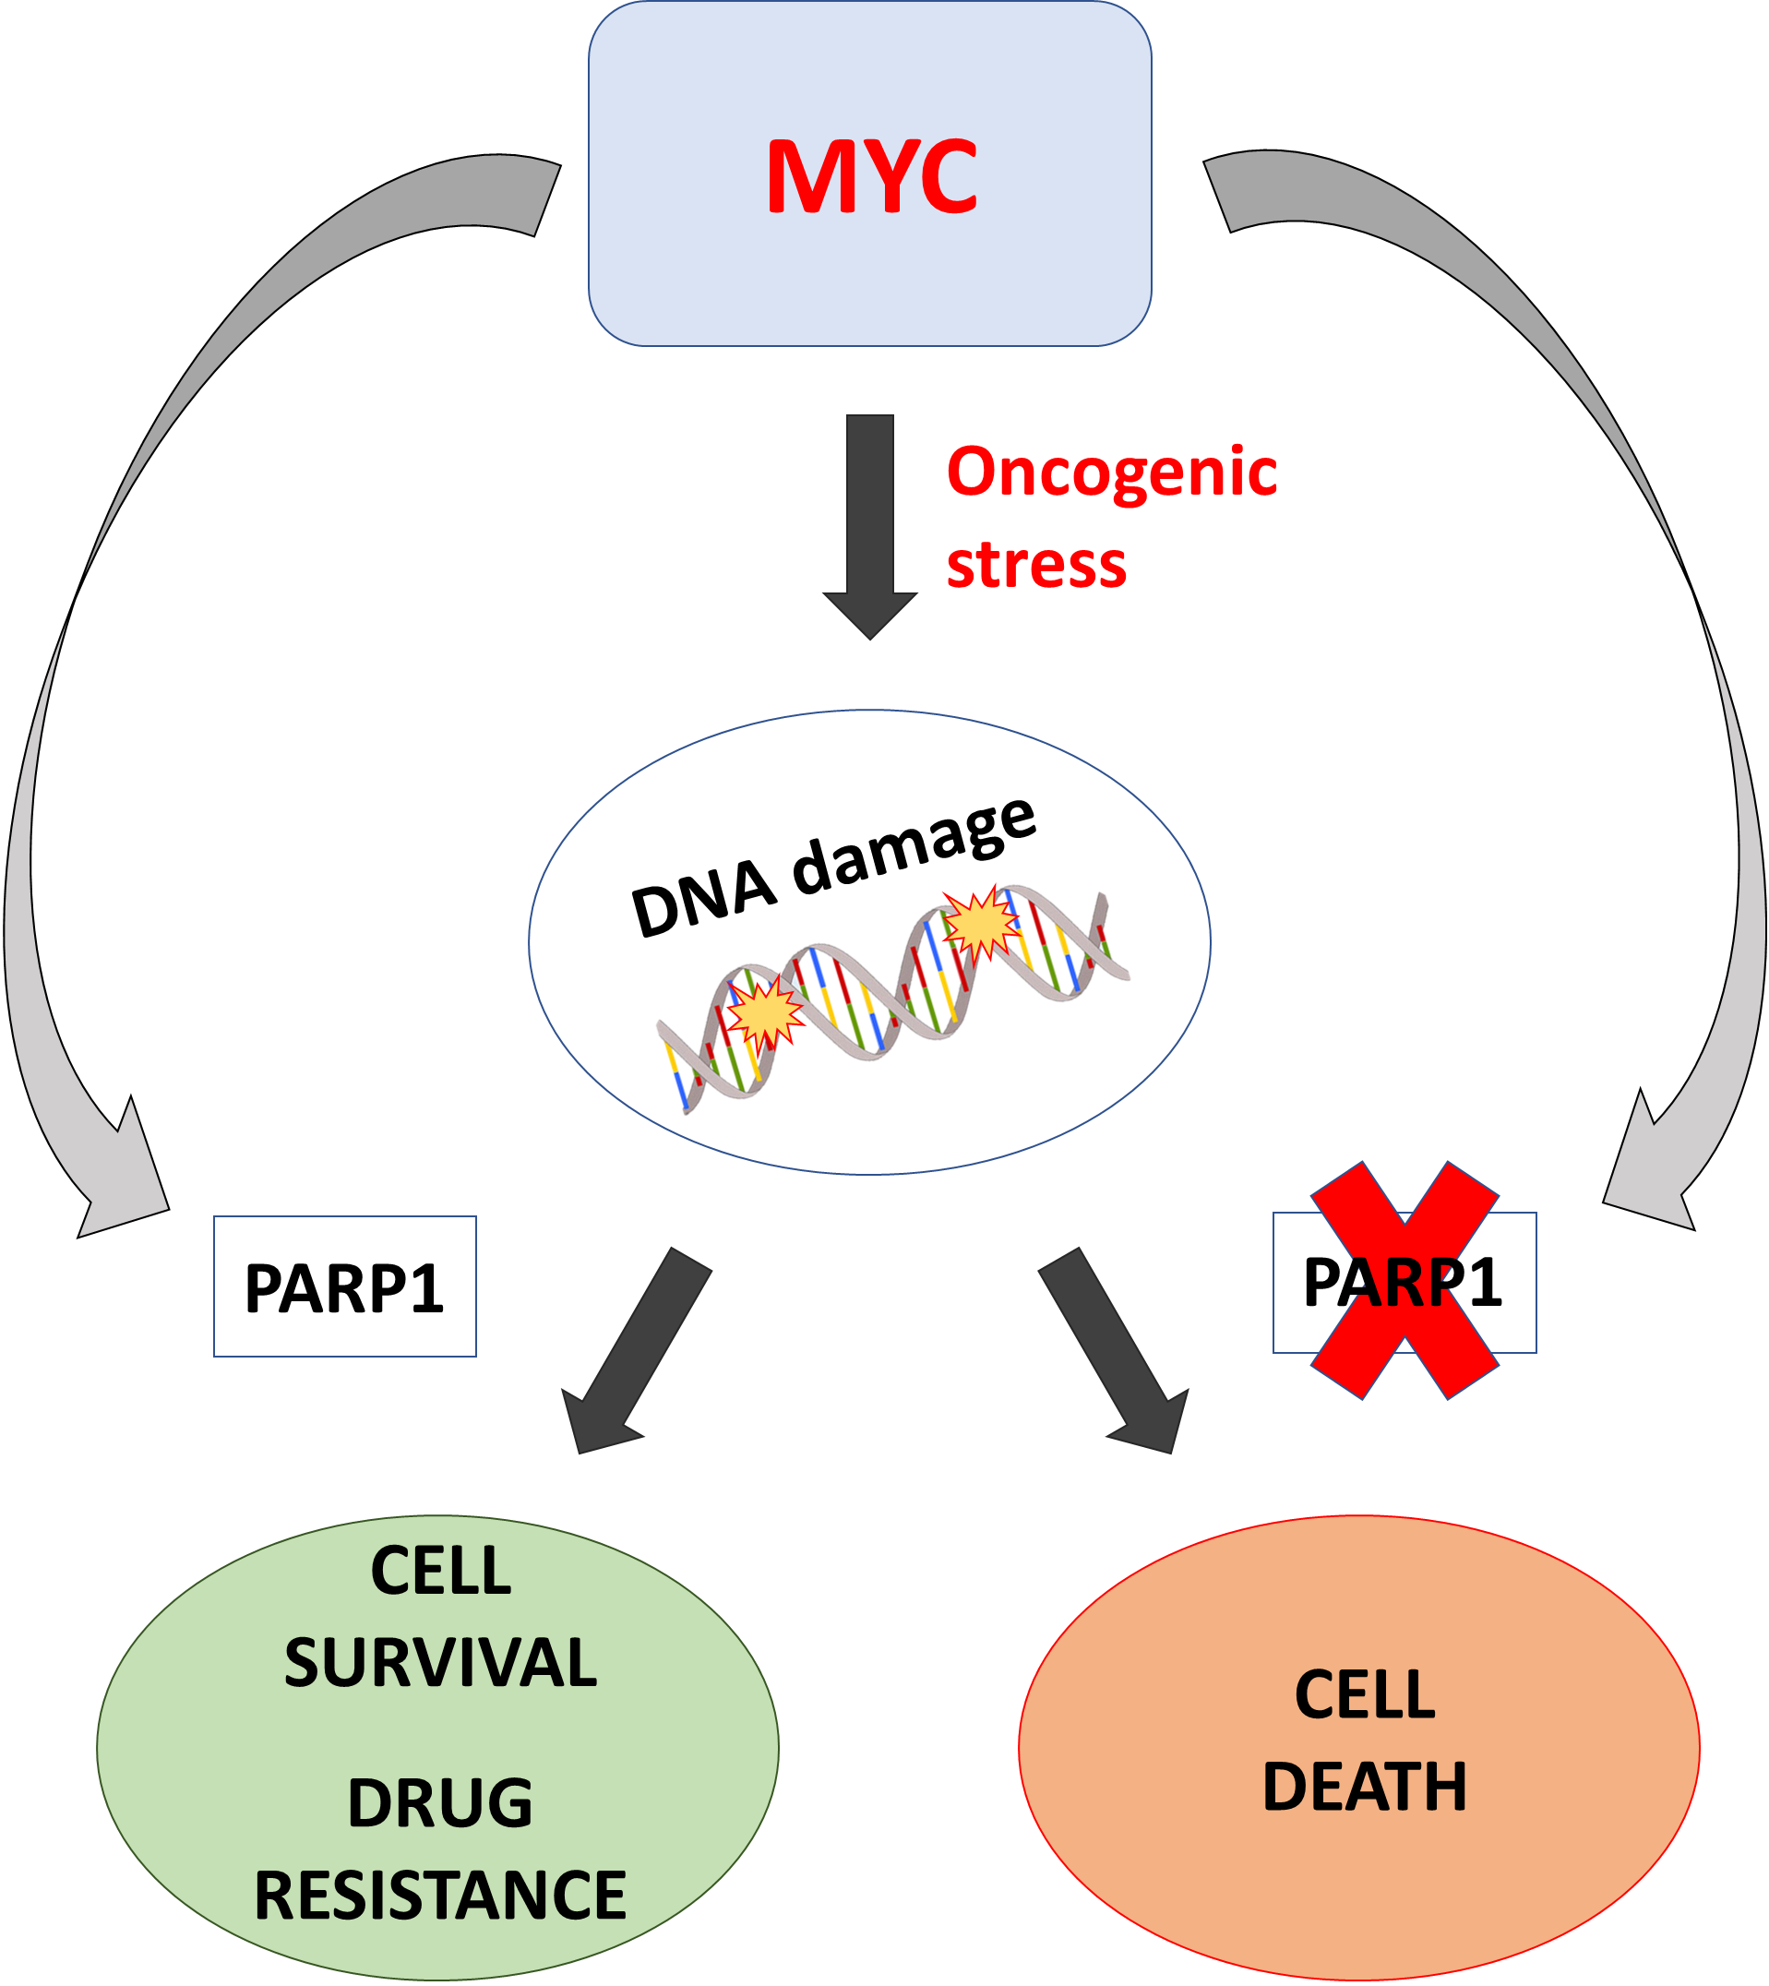
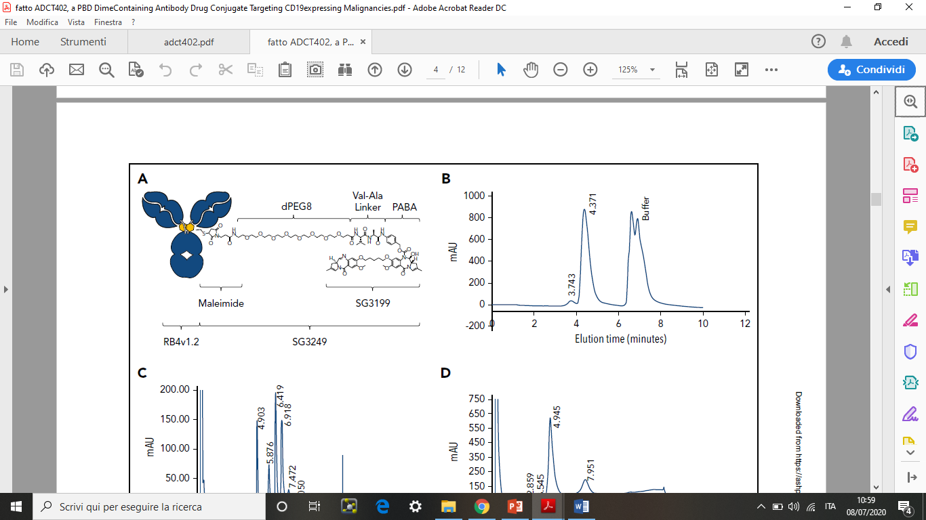
Targeting PARP in combination with CD19-selective delivery of DNA damage in DLBCL
Caracciolo D, et al. Exploiting MYC-induced PARPness to target genomic instability in multiple myeloma. Haematologica. 2021 Jan 1.
Humanized IgG1 antibody RB4v1.2 – antiCD19
MYC
PBD dimer
PARP1 Expression
High
Low
Zammarchi F, et al. Blood. 2018 Mar 8;131(10):1094-1105.
Notes:
CAMBIA citazione

Slide 3
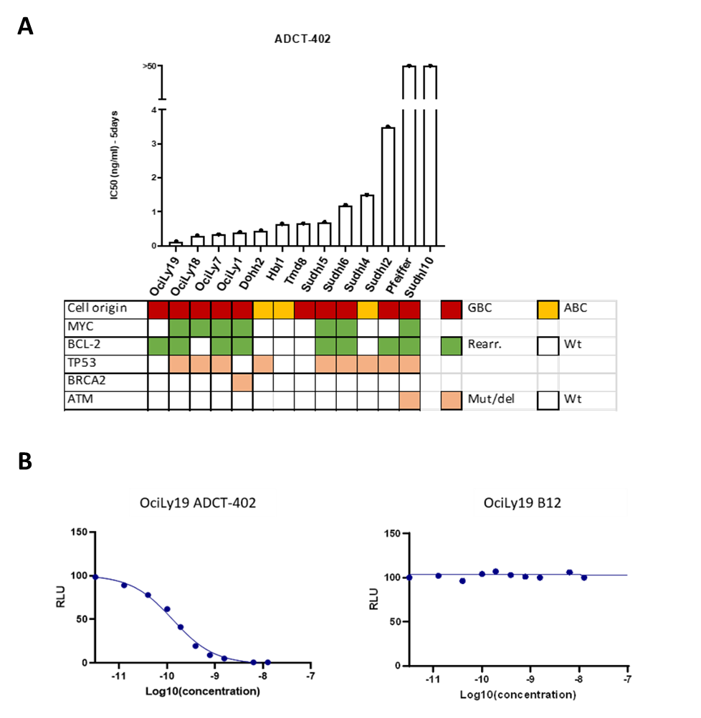
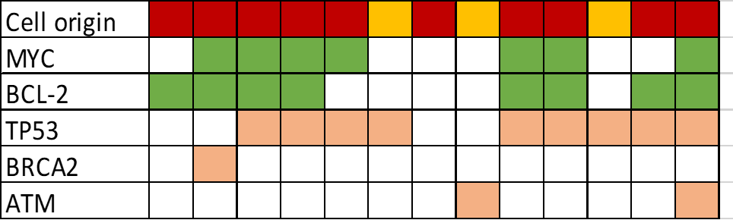
In vitro single agent activity of Loncastuximab tesirine and Talazoparib
OciLy19 Lonca
OciLy19 B12
 | GCB
 | ABC
 | Rearr.
 | Mut/del
 | Wt
Cancer Cell Line Encyclopedia; canSAR BLACK; COSMIC-Catalogue of somatic mutations in cancer.

Slide 4
DDR inhibition by Talazoparib enhances the cytotoxic effects of Loncastuximab tesirine in DLBCL cell lines
Lonca +Talazoparib
CTG analysis
Combination index analysis:
low dose:
Lonca 0.25 ng/ml-Talazo 25nM
med dose:
Lonca 0.5 ng/ml-Talazo 50nM
high dose:
Lonca 1 ng/ml-Talazo 100nM
1st
2nd
3rd
4th
5th
days
 | GCB
 | ABC
 | Rearr.
 | Mut/del
 | Wt
Cancer Cell Line Encyclopedia; canSAR BLACK; COSMIC-Catalogue of somatic mutations in cancer.

Slide 5
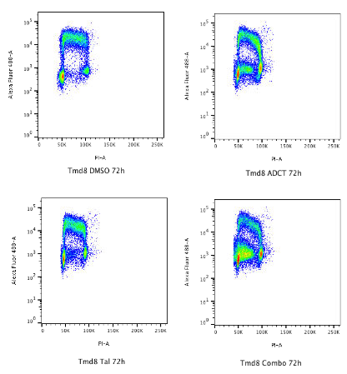
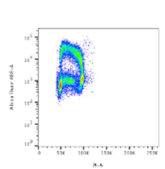
Talazoparib enhances Lonca-mediated
S phase cell cycle arrest
1. Cell cycle analysis with Propidium Iodide
2. Cell cycle analysis with Propidium Iodide and Brdu
72h
Tmd8 -72h
S phase
G2/M phase
Tmd8 -72h
DMSO
Lonca
S+
G2
G1
Sudhl5 -72h
Talazoparib
Combo
S-
Aggregate data analysis of cell cycle variations after 72h of treatments in 10 representative DLBCL cell lines.

Slide 6

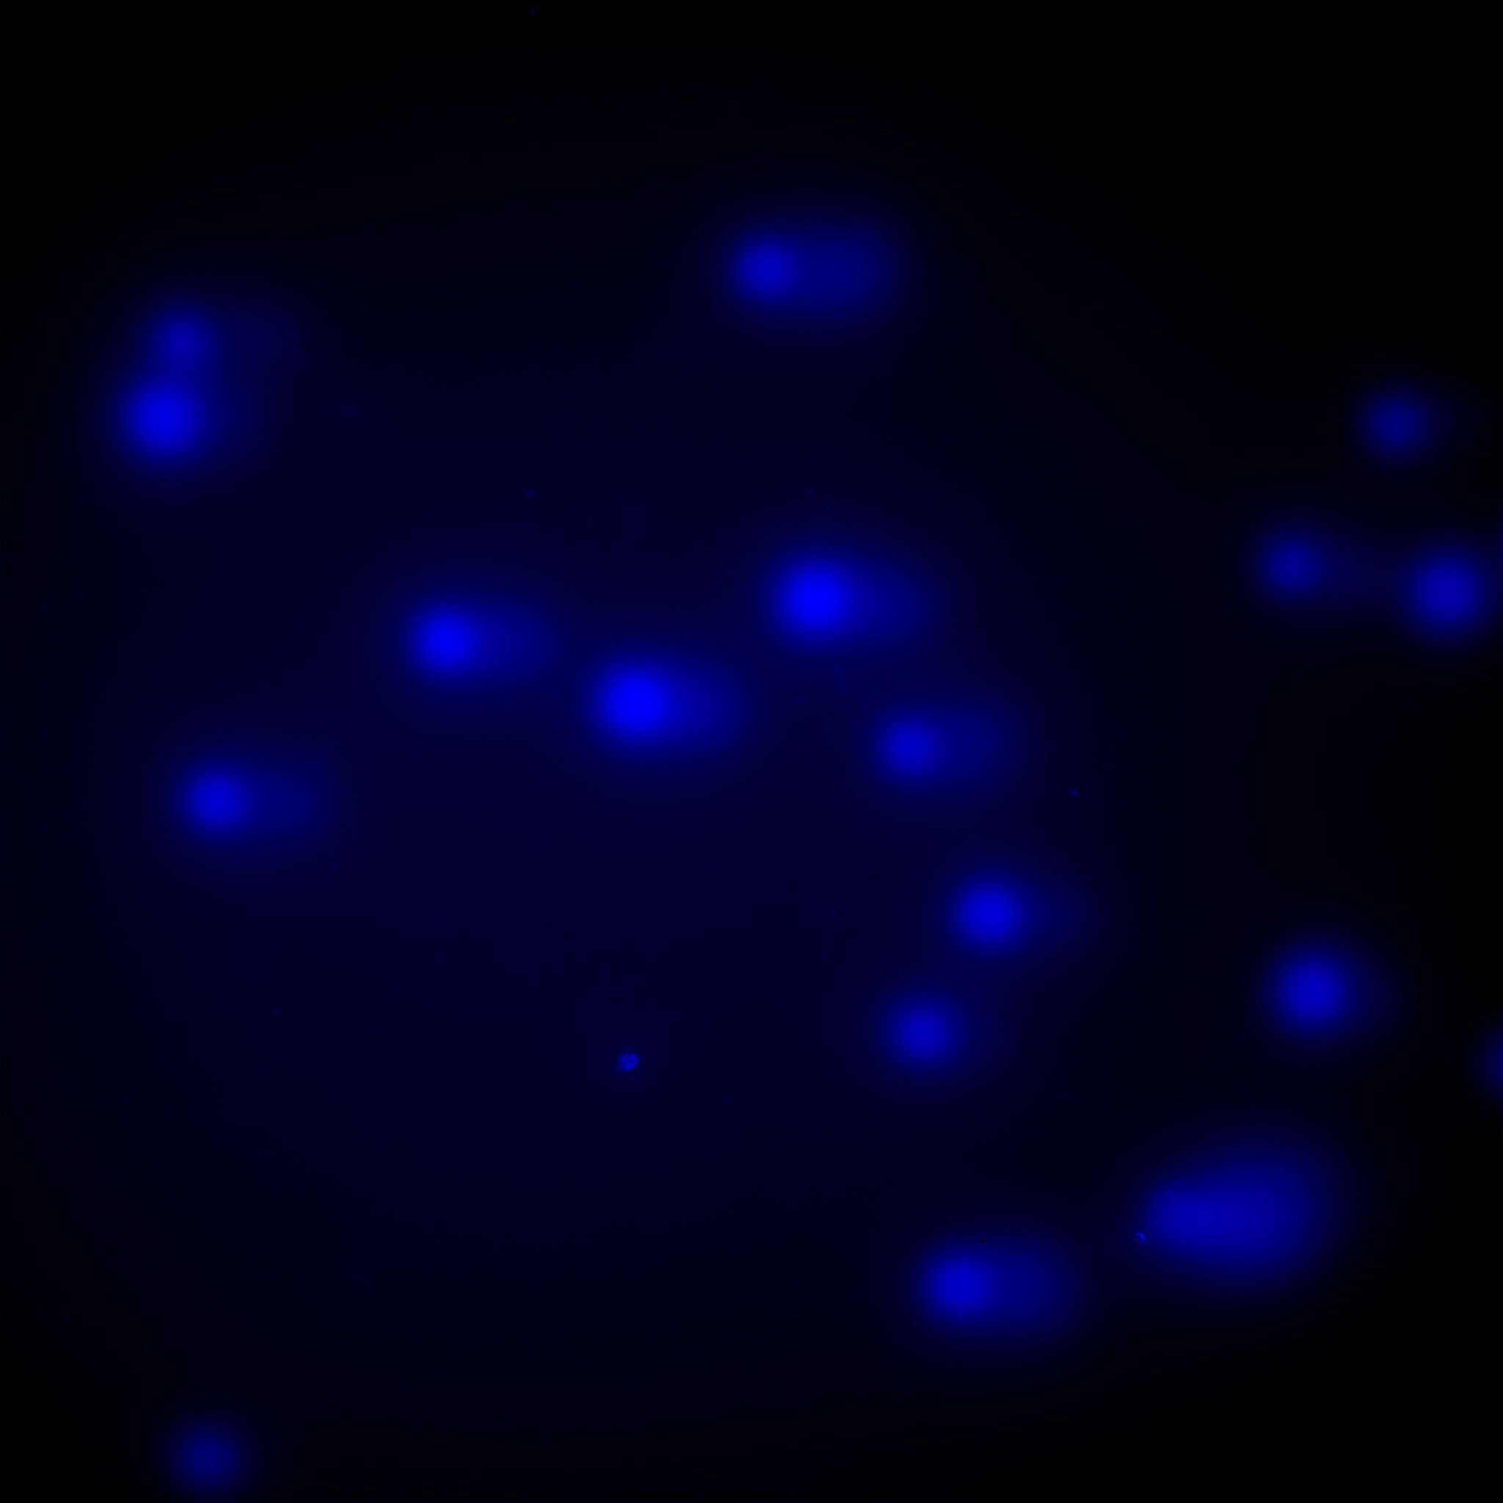

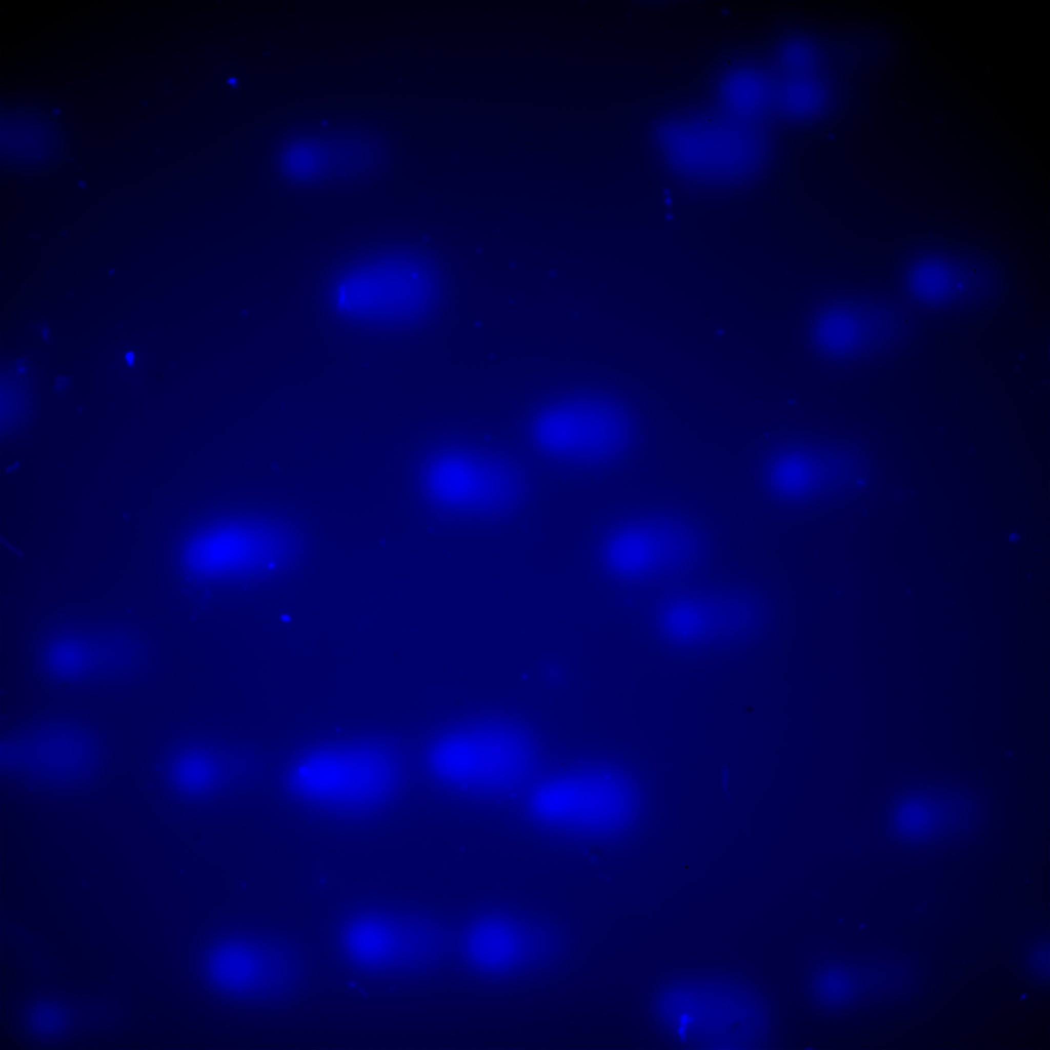
DNA damage detection in DLBCL cell lines and healthy donors-derived B and T cells
Sorting
OciLy18 – 24h
B cells
Lonca
CD20
DMSO
Lonca
PARPi
Peripheal blood
Combo
CD3
B12 isotype
T cells
B cells – 24h
T cells – 24h
Talazoparib
Combo

Slide 7
Conclusions
Talazoparib significantly enhances Loncastuximab tesirine anti-proliferative effects in DLBCL cell lines.
Combinational treatment induces S-phase cell cycle arrest suggesting a mechanistic interaction between the two drugs
DDR inhibition by Talazoparib boosts Lonca-mediated DNA damage in neoplastic B cells.

Slide 8
Disclosures:
Zammarchi: ADC Therapeutics: Current Employment, Current equity holder in publicly-traded company, Patents & Royalties.
Van Berkel: ADC Therapeutics: Current Employment, Current equity holder in publicly-traded company, Patents & Royalties.
Pileri: NANOSTRING: Other: ADVISORY BOARD; ROCHE: Other: ADVISORY-BOARD; CELGENE: Other: ADVISORY BOARD.
Tarella: ADC-THERAPEUTICS: Other: ADVISORY BOARD; Abbvie: Other: ADVISORY BOARD.
Derenzini: TG-THERAPEUTICS: Research Funding; ASTRA-ZENECA: Consultancy, Other: ADVISORY-BOARD; BEIGENE: Other: ADVISORY BOARD; TAKEDA: Research Funding; ADC-THERAPEUTICS: Research Funding.

